Slide 1

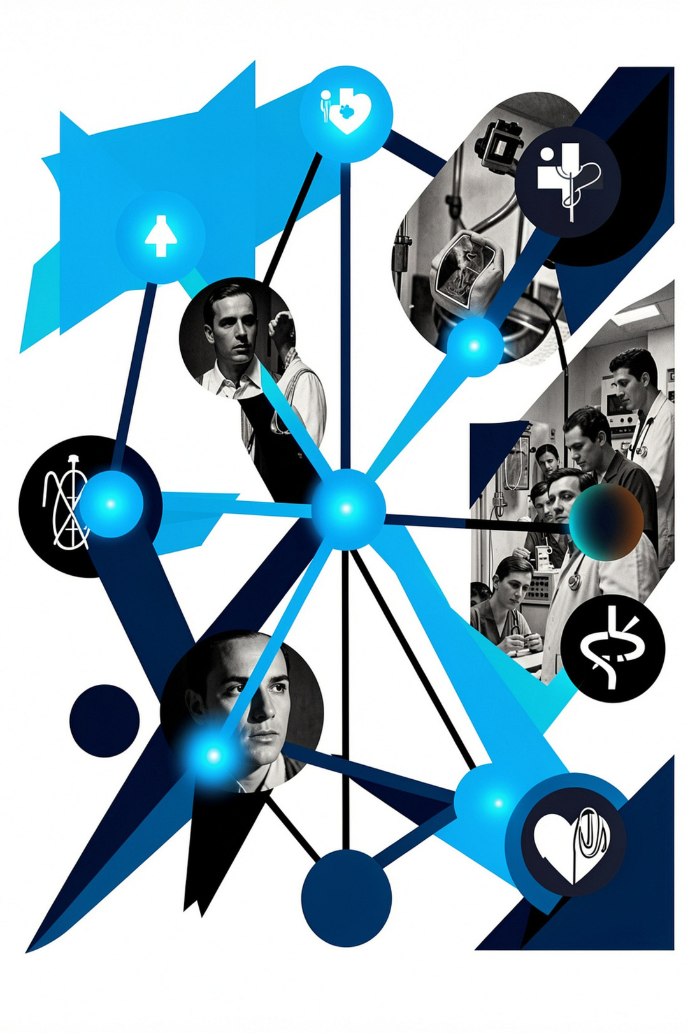
Patient Sovereign Prescription Intelligence Network
MathX Innovation 26
TEAM NAME:CHAIN BREAKERS
TEAM MEMBERS:
Madihur Rasool M
Lokesh Kumaar K
Maheshwar S
Shreesh Kirubanandhan A
Notes:
1

Slide 2
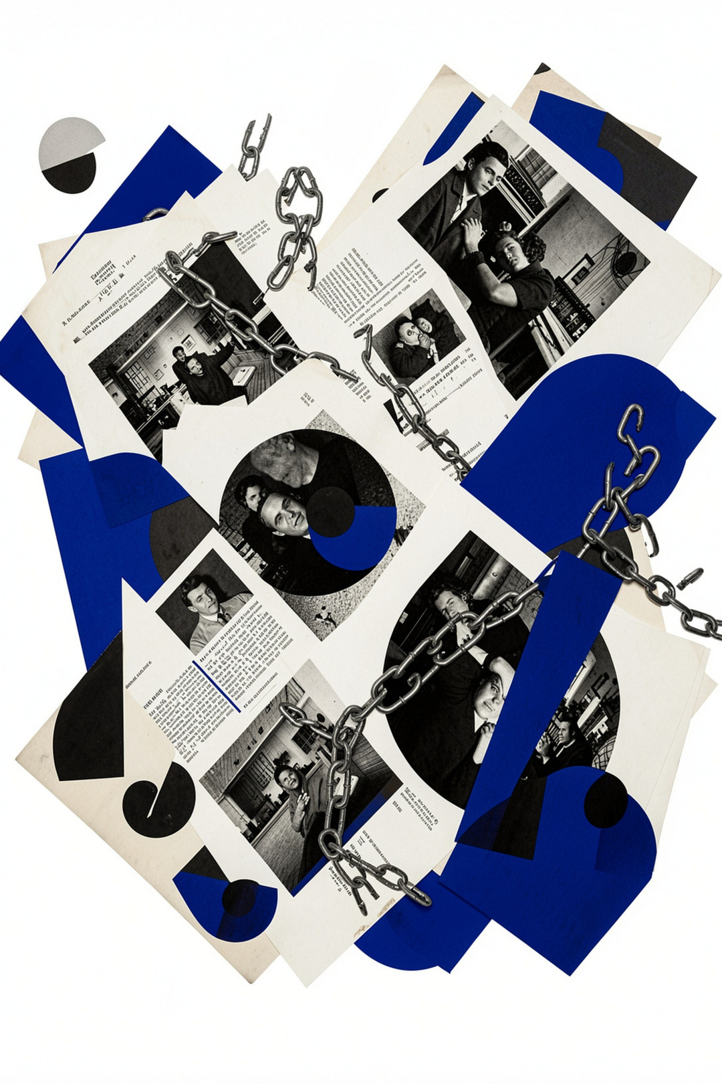
The Problem: Fragmented Prescription Chaos
Scattered records across hospitals and clinics — no single source of truth.
Lost or forged paper prescriptions create dangerous gaps.
Doctors lack complete medication histories, so harmful interactions can go undetected.
Patients have no ownership over their own health records.
Notes:
2

Slide 3
Why This Matters
🚨 Patient Safety
Undetected drug interactions, duplicate prescriptions, and prescription fraud put lives at risk every day.
💸 Healthcare Costs
Redundant diagnostic tests, delayed treatments, and preventable errors drain billions from the system annually.
⚙️ System Inefficiency
Poor continuity of care across providers creates cascading failures in treatment quality and outcomes.
Notes:
3

Slide 4


Our Solution: A Patient-Centric Ecosystem
Patient-owned, secure, and easy to share when needed.
Patient-Owned Vault
Secure, transparent prescription storage with full patient ownership and audit trail.
AI Interaction Detection
Real-time drug interaction analysis and fraud prevention powered by intelligent AI.
Consent-Based Sharing
Cross-hospital interoperability with QR and digital verification — patients control who sees what.
Smart Reminders
Automated medication reminders and refill workflows to close the loop on treatment adherence.
Notes:
4

Slide 5
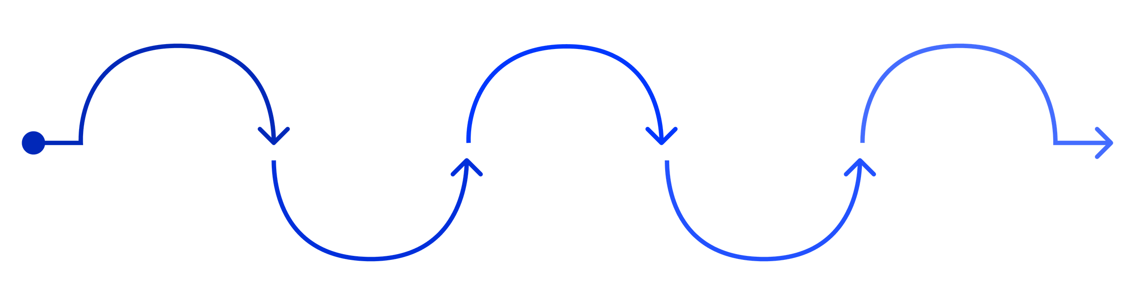
Platform Architecture
Doctor Portal
Secure Platform
Patient App
Pharmacy Portal
Hospital Systems
Creates prescriptions securely
Encrypts and stores data
Manages consent and records
Verifies scripts and detects fraud
Syncs for interoperability
The flow moves from doctor to secure platform to patient, pharmacy, and hospital systems through one encrypted, consent-based backbone.
Notes:
5

Slide 6
Technical Stack
Simple, secure, and built for interoperability.
Frontend
Backend
Database
Auth & AI
React & Flutter for web and mobile access
Node.js / FastAPI for secure APIs
PostgreSQL with encryption at rest and in transit
JWT, OAuth, MFA, and drug interaction checks
Notes:
6

Slide 7
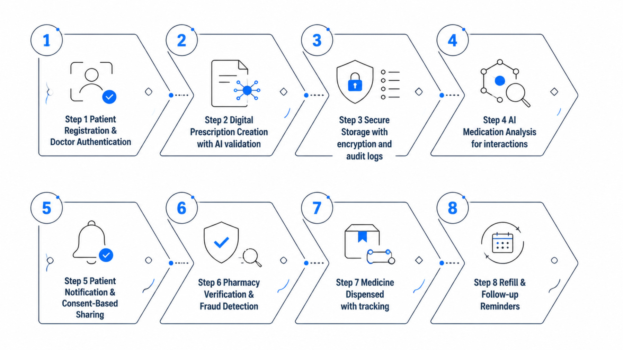
Implementation Workflow
Each step supports secure, compliant, and traceable care from registration to follow-up.
Notes:
7

Slide 8
Operational Feasibility
Adoption: Intuitive mobile and web interfaces mean minimal training for doctors, pharmacists, and patients.
Integration: Built to work with existing hospital systems without a rip-and-replace approach.
Scalability: Cloud-native architecture can scale from regional to global deployment.
Notes:
8

Slide 9
Risk Mitigation Strategy
Built for Trust at Every Layer
Data Breach: End-to-end encryption, MFA enforcement, and hardened secure APIs across all endpoints.
Unauthorized Access: Consent-based sharing model with strict role-based access control.
AI Errors: Doctor approval required before any final prescription is issued.
Downtime & Inconsistency: Cloud redundancy and FHIR-compliant data standards ensure continuity.
Notes:
9

Slide 10


Impact & Future Vision
Patients — Full ownership, improved safety, and seamless continuity of care across every provider.
Doctors — Complete medication histories, smarter decisions, and dramatically fewer prescription errors.
Pharmacies — Instant digital verification and AI-powered fraud prevention at the point of dispensing.
Healthcare System — True interoperability, reduced administrative burden, and a foundation of enhanced institutional trust.
"Transforming fragmented prescription management into a secure, intelligent, patient-centric healthcare ecosystem."
Notes:
10

Slide 11
Thank You
Notes:
10

